Slide 1

CONTENT BASED MOVIE RECOMMENDER SYSTEM
Leveraging Machine Learning and Natural Language Processing
Presented by
Snigdha Chigurupati
DATA 606 – Capstone Project
Prof. Chaojie Wang
August 15th, 2023

Slide 2

Introduction
Introducing Recommender Systems: Recommender systems are algorithms designed to predict users' preferences and suggest products or services accordingly. In the context of movies, they help platforms tailor suggestions based on individual taste.
Differentiating Content-Based, Collaborative Filtering and Hybrid model: While content-based systems recommend movies based on characteristics of items the user has liked, collaborative filtering considers preferences from similar users.

Slide 3
Importance of Movie Recommender systems
Recommender systems help viewers efficiently find movies matching their interests from vast catalogs; manually locating relevant titles is infeasible.
For platforms, high-quality recommendation algorithms enhance user satisfaction and retention; e.g. 80% of Netflix content is from recommendations.
Personalized suggestions keep users engaged by catering to individual interests and promoting discovery of new content.
Sophisticated AI techniques enable deeper understanding of movie narratives for fine-grained recommendations aligned to nuanced preferences.

Slide 4

DATA SOURCE
This dataset from kaggle created by Ashish Jangra has the data of size, 661 MB.
Total observations: 2590932
Features:
id - Movie ID
name - Name of the Movie
year - Year of movie release
rating - Rating of the Movie
certificate - Movie Certification
duration - Duration of the Movie
genre - Genre of the Movie
votes - Number of people who voted for the IMDB rating
gross_income - Gross Income of the Movie
directors_id - ID of Directors who have worked on the movie
directors_name - Name of the movie director
stars_id - Star ID
stars_name - Name of the stars in the movie
description - Movie description
Dataset link: https://www.kaggle.com/datasets/ashishjangra27/imdb-movies-dataset

Slide 5
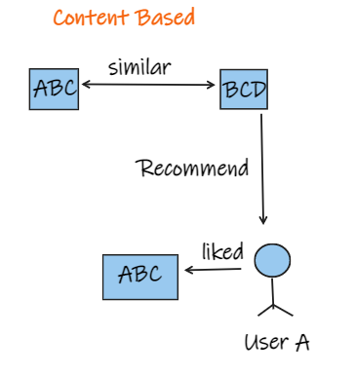
Content-Based Recommender Systems
Explanation of Content-Based Systems: They recommend items similar to those the user liked, based on item features.
Utilizing Features Like Genre, Cast, and Plot: For movies, features could include genres, directors, actors, and plot keywords.

Slide 6
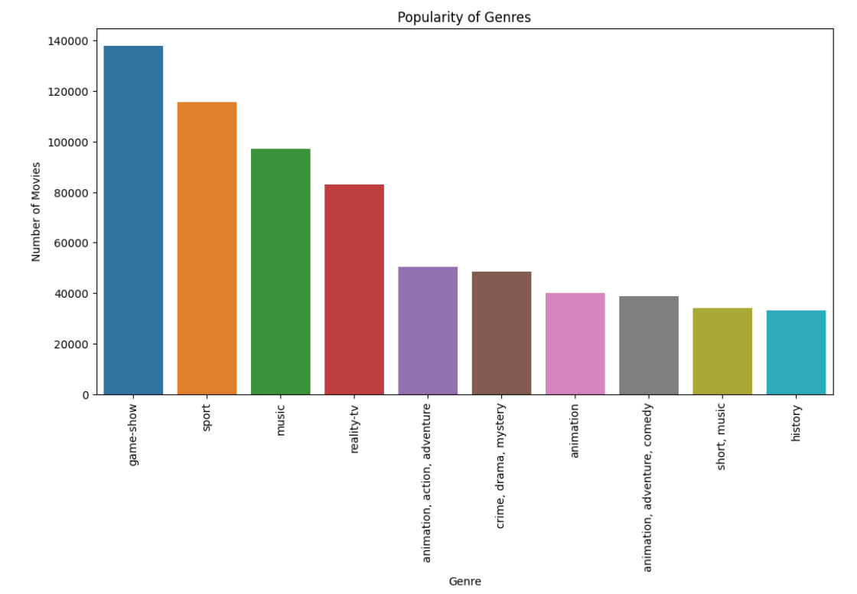
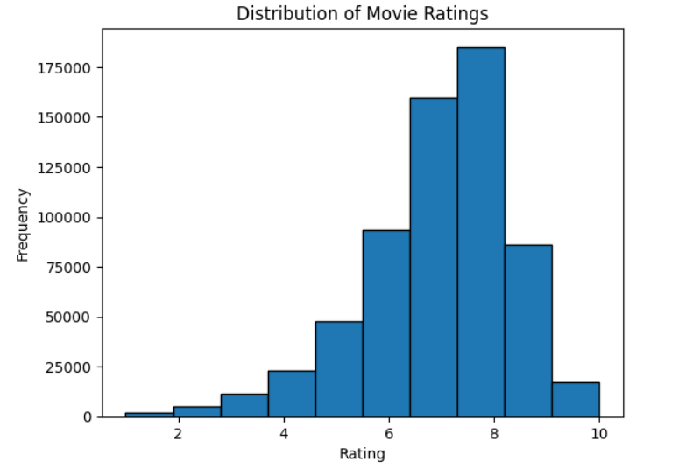
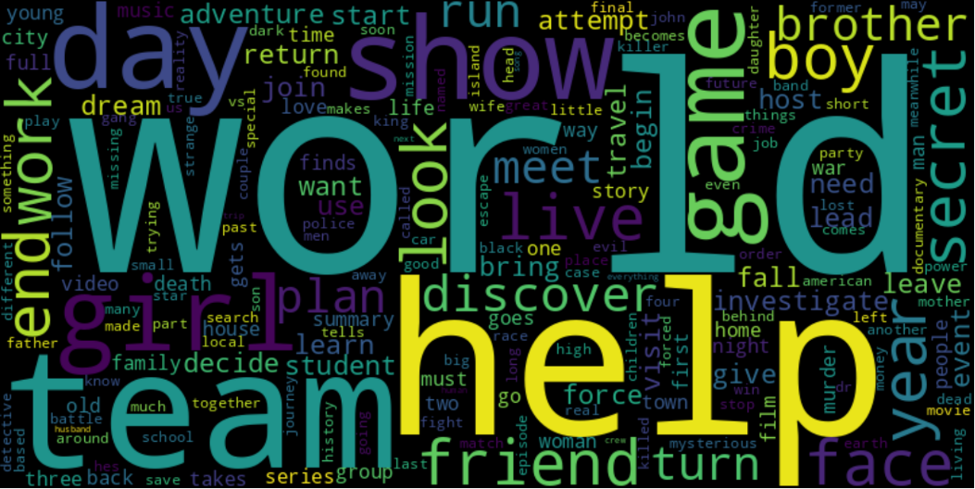

Slide 7
Data preprocessing techniques
Checking for Null values
Dropping the duplicates
Feature Selection
Removing the stopwords and punctuations
Performing Lemmatization

Slide 8
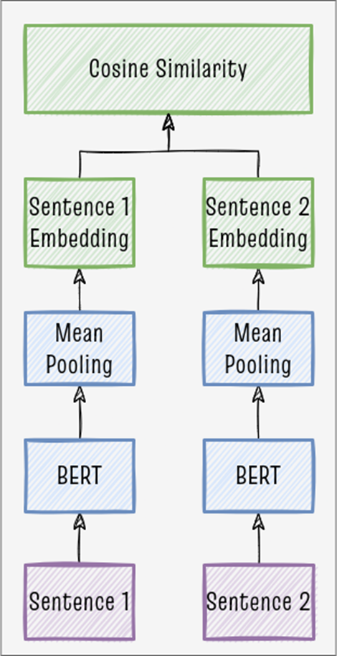
Similarity Measures and BERT Integration
Cosine Similarity: A metric used to measure how similar two items are, especially beneficial when dealing with high-dimensional data like text. It measures the cosine of the angle between two vectors, and it's often used in text analysis.
BERT (Bidirectional Encoder Representations from Transformers): BERT is a powerful pre-trained deep learning model used for various NLP tasks. It represents text in high-dimensional space where semantic meanings of words are captured.
Combining BERT with Cosine Similarity for Recommendations:
Text Representation: BERT transforms movie descriptions into numerical vectors.
Calculating Similarity: Cosine similarity is then used to calculate how similar the user's input is to the movies in the database.
Personalized Recommendations: Based on these similarities, personalized movie recommendations are provided to the user.

Slide 9
Advantages of using BERT:
Understanding Context: BERT understands the context of words in the text by looking at all the words in a sentence rather than one by one in order.
Pre-trained Knowledge: It comes with the advantage of being trained on a large corpus of text, allowing it to understand subtle nuances of language.
High Performance: BERT is known for state-of-the-art results in many NLP tasks, providing a strong foundation for the recommender system.

Slide 10

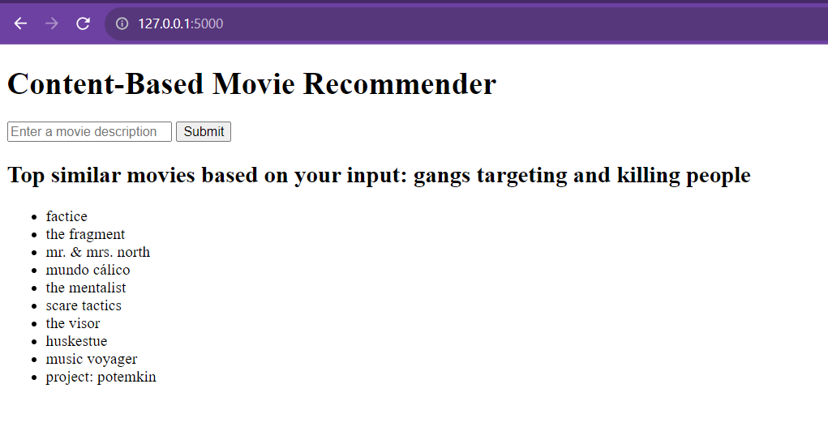
Deployment using FLASK

Slide 11
Case Studies – Movie Recommendations in the Real World
Netflix:
Personalized Experience: Netflix uses content-based filtering along with other techniques to provide personalized movie and TV show recommendations.
Tagging System: Movies and shows are tagged with relevant genres, directors, actors, and even abstract concepts, forming the basis for content-based recommendations.
Impact: It's estimated that 80% of the content watched on Netflix comes from recommendations, highlighting the efficacy of their system.
Amazon Prime Video:
Content-Based Filtering: Amazon utilizes user behavior, preferences, and content metadata to suggest relevant products, including movies and series on Prime Video.
Impact: Their recommendation system drives a significant portion of user engagement, helping in user retention and increasing average watch time.
YouTube:
Hybrid Recommender System: YouTube employs a combination of content-based and collaborative filtering to recommend videos.
Deep Neural Networks: They use deep learning algorithms to understand user behavior and content characteristics.
Impact: Recommendations are crucial in driving user engagement, accounting for more than 70% of the time spent on the platform.
Spotify:
Music Recommendations: Though not a movie platform, Spotify's use of content-based filtering for music recommendation is a noteworthy example.
Audio Analysis: Analyzing various aspects of the music itself, such as tempo, key, valence, and danceability, to make personalized recommendations.
Impact: Creates unique playlists and enhances user experience, keeping users engaged with the platform.

Slide 12

Challenges and Future Directions
Current Challenges:
Scalability: Managing computational resources when dealing with a large number of users and items.
Diversity: Ensuring that recommendations are not too narrow or repetitive.
Cold Start Problem: Difficulty in providing recommendations for new users or items without sufficient data.
Privacy Concerns: Balancing personalization with users' privacy.
Future Directions:
Hybrid Recommendation Systems: Combining content-based with other techniques, like collaborative filtering, for more robust recommendations.
Incorporating Deep Learning: Advanced deep learning techniques can add more layers of complexity and understanding.
Personalized User Experience Enhancement: Focusing on user experience design that complements intelligent recommendation.

Slide 13
Potential Impact on the Industry
Transforming Consumer Experience:
Personalization at Scale: Content-based recommender systems enable platforms to offer tailored experiences to millions of users, thereby enhancing satisfaction and loyalty.
Discovery and Exploration: By recommending content that aligns with users' interests, these systems encourage discovery and exploration, enriching the overall user experience.
Driving Business Growth:
Increased Engagement: By recommending relevant content, businesses can significantly increase user engagement, leading to higher retention rates.
Revenue Growth: Personalized recommendations contribute to increased consumption, influencing purchasing decisions, and subsequently boosting revenue.
Marketing Efficiency: Targeted recommendations allow businesses to market their products more effectively, optimizing advertising spend.

Slide 14
Potential Impact on the Industry
Innovation and Research Opportunities:
Cutting-Edge Technology Integration: The integration of advanced technologies like BERT fosters continuous innovation in content analysis and recommendation techniques.
Cross-Domain Applications: Beyond entertainment, content-based recommender systems have potential applications in various domains such as e-commerce, education, and healthcare, paving the way for diversified research opportunities.
Ethical and Sustainable Development: Research is also focusing on developing responsible recommender systems that align with ethical considerations and promote diversity and inclusivity in recommendations.
Building a Competitive Edge:
Staying Ahead in the Market: The implementation of sophisticated recommender systems enables businesses to stay competitive by offering unique and compelling user experiences.
Data-Driven Decisions: Leveraging the insights gained from user behavior, businesses can make informed decisions that align with consumer needs and market trends.

Slide 15
THANK YOU

